Slide 2
Our Panelists
Matt Davis - Matthew is a Vice President and Claims Manager at Swiss Re Corporate Solutions in Kansas City, Missouri, with 26 years of experience working in and for the insurance industry. He joined Swiss Re in 2004, where he has focused his attention on professional liability claims involving both insurance agents and lawyers throughout the United States and Canada. Matt earned his law degree from the University of Texas.
Jim Redeker - Jim is a Vice President and Claims Manager at Swiss Re Corporate Solutions in Kansas City, Missouri, with 20 years of experience working in and for the insurance industry. He joined Swiss Re in 2002, where he has focused his attention on professional liability claims involving insurance agents throughout the United States. Jim earned his law degree from Washburn University School of Law.

Slide 3
Administrative Details
Attendees are in listen only mode.
Questions? Please use the Gotowebinar questions feature in the upper right and we will do our best to respond.
For panelist questions after the webinar:
Matt Davis - Matthew_Davis@swissre.com
Jim Redeker - James_Redeker@swissre.com
No CE or loss control credit for listening to today’s discussion.
The slides and audio will be available on E&O Happens soon.

Slide 4
Our Agenda
Recommendation Errors
Explanation Errors
Application Errors
Policy Renewal/Replacement Errors
Policy Change Errors

Slide 5
Does this really apply to me? Do you write any of these coverages:
Coverage | % of E&O Claims on Commercial Business
CGL | 29%
Commercial Property | 21%
Workers Compensation | 9%
Auto | 9%
Professional Liability | 7%
BOP/Special Multi-Peril | 5%
Inland Marine | 2%
Crop | 2%
Farm Owners | 2%
Truckers Coverage | 2%
Bonds | 2%
A&H | 1%
Builders Risk | 1%
Flood | 1%
Umbrella-Excess | 1%
Garage Coverage Form | 1%
Crime | 1%
Liquor Liability | 1%
Business Interruption | 1%

Slide 6
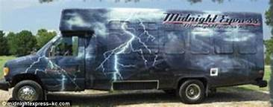
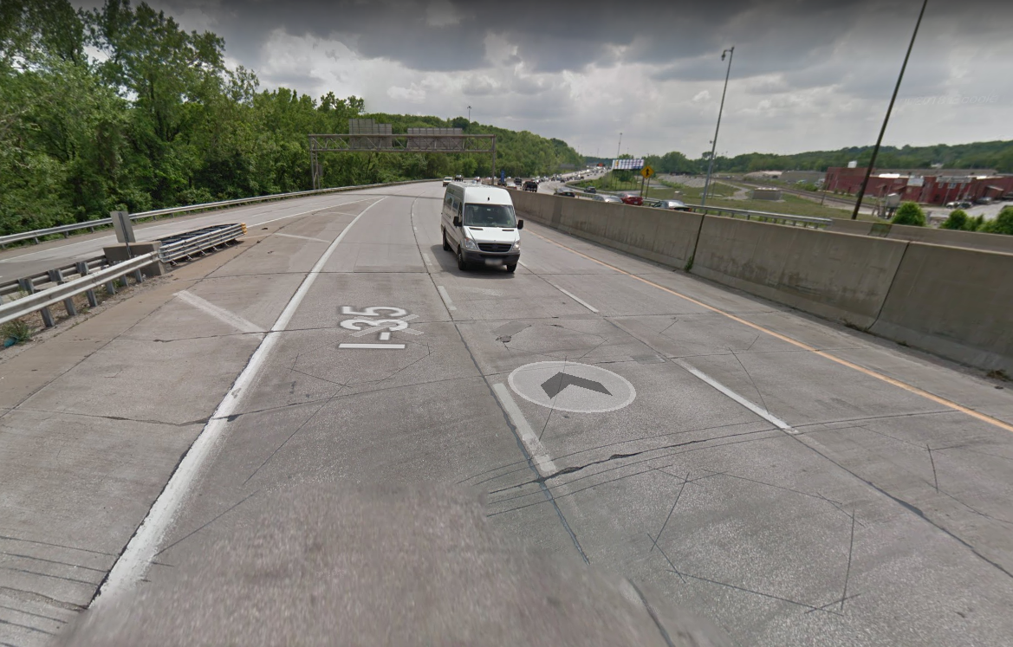
Recommendation Errors Lack of knowledge / dabbling

Slide 7
Takeaways
Never attempt to place coverage by yourself if you are unfamiliar with the coverage, or the property/risk is outside your usual geographic area.
Associate yourself with a broker or another agent who is familiar with the coverage or geographic area.
Your state or national association can help with referrals.
If necessary, tell your customer you aren’t familiar with the product or region, so they should use another agent to place the coverage.

Slide 8
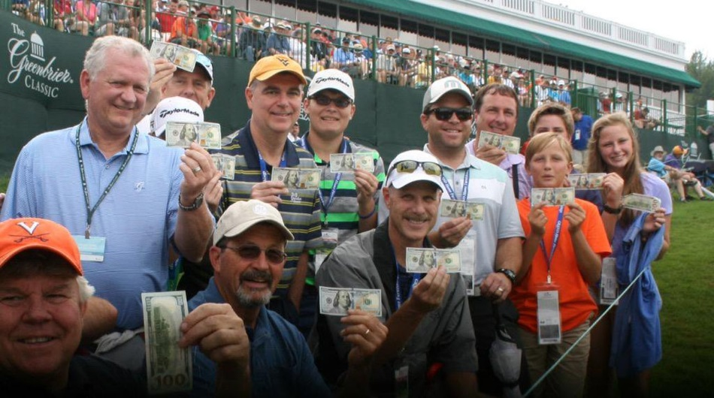
Explanation Errors The Devil is in the Details

Slide 9
Takeaways
Don’t let your customer’s procrastination become your E&O claim.
Review the policy to make sure it meets with your customer’s request.
Be sure to deliver the policy to your customer, so they have an opportunity to review it prior to the special event – and urge them to do so.
If the policy has unusual features, e.g., yardage, fire alarm or occupancy requirements? Bring that to your client’s attention.

Slide 10
Application Errors What’s in a Name?

Slide 11
Takeaways
30 of 50 states do not require proof that the carrier relied on a misrepresentation to void coverage, only that it be ‘material to the risk’ the carrier assumed.
Pay close attention to the questions asked and the responses given.
Record full and accurate responses to the application questions. Make no assumptions.
Be sure to have your customer sign the application and retain a copy of the signed application in your agency file. Provide a copy of ‘E-applications’.

Slide 12
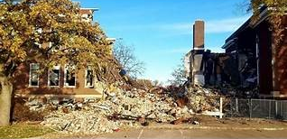
Policy Renewal/Replacement Errors The only constant is change…

Slide 13
Takeaways
Do not recommend the amount of coverage your customer should purchase for his property.
Instead, suggest that the customer obtain an appraisal or rebuild estimate if he is unsure about the value of his property.
If the carrier requires you to use an estimator, double check the information you enter and be sure to document to the customer that this is only an estimate and they can purchase higher limits.
Don’t assume. Offer higher limits on a regular basis.

Slide 14
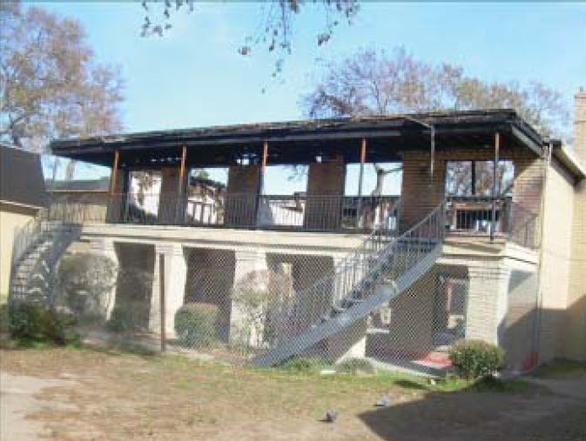
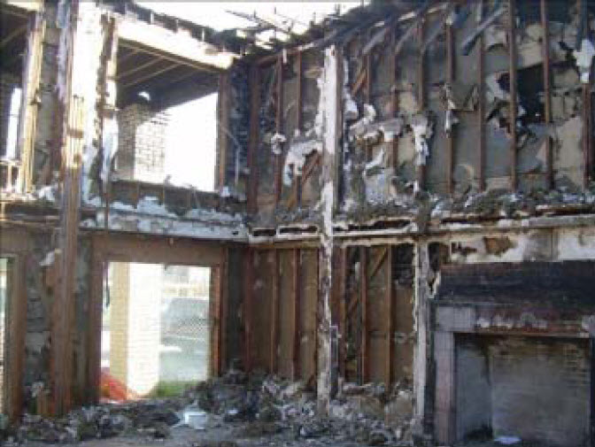
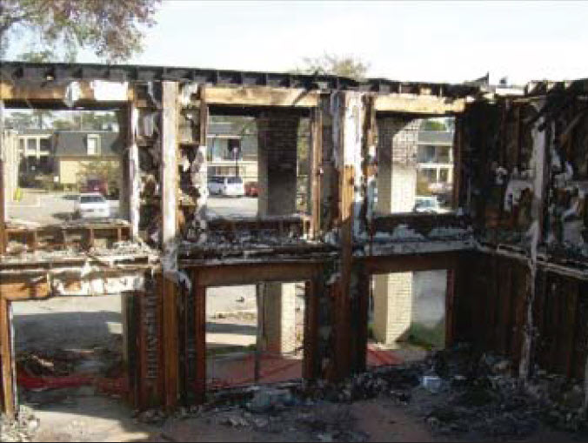
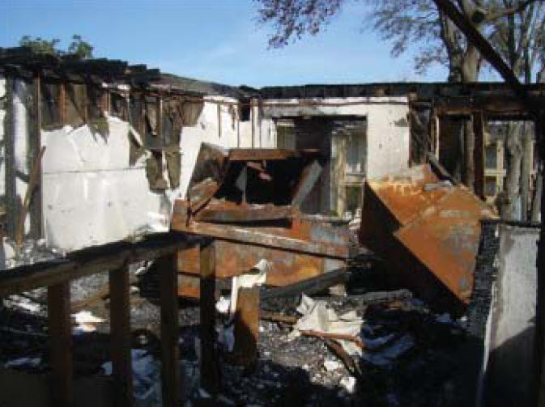
Policy Change Errors Never put off until tomorrow…

Slide 15
Takeaways
Follow-up immediately on requests to change coverage.
Do NOT send a COI showing a coverage change until AFTER the coverage has been changed.
Be sure to tell your customer his coverage change does not take place until he receives his new COI.
Discourage last-minute requests from your customer. They are a prime breeding-ground for E&O claims.
If you cannot make a last-minute change? Say so.

Slide 16
Big “I” Related Resources:
Stay in Your Lane- Author: James Redeker
Out of your Depth- Author: Matthew Davis
Tricks of the Trade- Author: Brian Butcher
Deceptively Simple- Author: Matthew Davis
5. Standard of Care Interactive Map

Slide 17
Panelist Contact Information:
Matt Davis - matthew_davis@swissre.com
Jim Redeker - james_redeker@swissre.com
Jim Hanley - jim.hanley@iiaba.net
Richard Lund - richard_lund@swissre.com
Louise Barron - louise_barron@swissre.com

Slide 18
Thank you!

